Slide 1
Running a Forms
Developer Application
Notes:
Schedule: Timing Topic
60 minutes Lecture
25 minutes Practice
85 minutes Total

Slide 2
Objectives
In this lesson, you will run an existing application on the Web in order to familiarize yourself with the run-time interface of the Oracle Forms Developer
After completing this lesson, you should be able to do the following:
  Describe the run-time environment
  Navigate a Forms application
  Retrieve both restricted and unrestricted data
  Describe the two modes of operation
  Insert, update, and delete records
  Display database errors
Notes:
Introduction
Overview
In this lesson, you will run an existing application on the Web in order to familiarize yourself with the run-time interface of the Oracle Forms Developer. You must understand the environment of the form operator before designing and building your own applications.

Slide 3




Running a Form
  Oracle Forms Services deployment:
Browser URL
Java Applet
  Deploying form applications to the Web is implemented by the three-tier architecture of Oracle9i Application Server
  Application logic and the Forms Services Runtime Engine reside on the middle-tier application server
  All trigger processing occurs on database and application servers , while user interface processing occurs on the Forms client
Notes:
Running a Form
Deploying form applications to the Web is implemented by the three-tier architecture of Oracle9i Application Server. Application logic and the Forms Services Runtime Engine reside on the middle-tier application server. All trigger processing occurs on database and application servers, while user interface processing occurs on the Forms client. End users can run Forms Developer applications in a Web browser.
Users request an application in their Web browsers by entering a URL that points to the application. Forms Services then generates an HTML file that downloads a Java applet to the client machine. This small applet is capable of displaying the user interface of any form, while the application logic is executed on the middle tier.

Slide 4

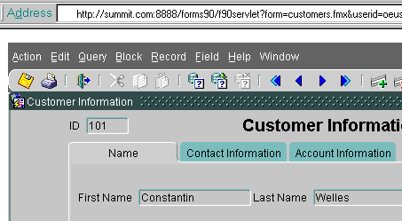

Running a Form: Browser
Users request an application in their Web browsers by entering a URL that points to the application. Forms Services then generates an HTML file that downloads a Java applet to the client machine.
How do I
access this application?
How do I access this new application?
http://summit.com:8888/forms90/f90servlet
?form=customers.fmx&userid=username/password@database
&buffer_records=NO&debug_messages=NO&array=YES
&query_only=NO
Notes:
Running a Form
The URL to invoke an application must have the following format: http://host[:port]/forms servlet or html file[parameters]
(optional portions of URL enclosed in brackets)
Summit’s URL consists of the following components:
Instructor Note
Mention to students that it is common to provide an HTML front end to allow the user to choose the application to start, then construct the URL based on the user’s choice.

Slide 5
The Java Runtime Environment
  The Forms applet runs in a Java Runtime Environment (JRE) on the client machine.
  Types of JREs:
    Java-enabled browser (native)
    JInitiator (Oracle-supplied plug-in to Web browser) that provides:
    Incremental Java archive (JAR) file downloading
    JAR file caching
    Applet instance caching
    Automatic Java security configuration
Notes:
The Java Runtime Environment
The Web browser can run a Java applet because it provides a Java Runtime Environment (JRE). However, not all Web browsers are able to natively run the Forms client. On Windows platforms, Oracle provides a plug-in called JInitiator that provides an alternate JRE capable of running the Forms applet.
JInitiator provides several benefits:
It is able to incrementally download the Java ARchive files (JAR files) needed for the Forms client, providing faster application startup.
It caches the JAR files locally, so that they do not need to be downloaded again.
It improves application performance within a browser session by applet instance caching. When a user navigates from the current page in the browser, the running Forms application is cached. When the user comes back to the page containing the applet, the applet that was running is automatically fully restored, including all of the data entered in the application.
It is automatically configured to run the Forms application in trusted mode. This enables the application to have access to resources that the Java sandbox model normally prohibits it from using, such as print services.

Slide 6



Starting a Run-Time Session
The user accesses the URL that indicates that a Forms application should be run
Client Tier
Middle Tier: Application Server
Web Browser
Web Server
1
Static HTML files
OC4J
or HTTP Server
2
URL
http://summit.com:8888/forms90/f90
Forms Services
3
Forms Servlet
Forms Listener Servlet
Forms Runtime Engine
The Forms Servlet dynamically creates an HTML page containing all the information to start the Forms session
Forms Application Executables
FMX files
MMX files
PLX files
DB
Notes:
Starting a Run-Time Session
Starting a Run-time session involves the following steps:
1. The user accesses the URL that indicates that a Forms application should be run.
2. The Oracle HTTP Server or OC4J receives an HTTP request from the browser client and contacts the Forms Servlet.
3. The Forms Servlet dynamically creates an HTML page containing all the information to start the Forms session.

Slide 7

Starting a Run-Time Session
Client Tier
Middle Tier: Application Server
Web Browser
Web Server
Static HTML files
OC4J
or HTTP Server
URL
http://summit.com:8888/forms90/f90
4
Forms Services
Forms Servlet
Forms Listener Servlet
Forms Runtime Engine
Applet
started
6
5
The client applet contacts the Forms Listener Servlet to start the session
Forms Application Executables
FMX files
MMX files
PLX files
DB
Notes:
Starting a Run-Time Session (continued)
4. The Oracle HTTP Server or OC4J downloads a generic applet to the client after checking that it has not already been downloaded. The client caches the applet so that it can run future Forms applications without downloading it again.
5. The client applet contacts the Forms Listener Servlet to start the session. The Forms Listener Servlet starts an instance of the Forms Runtime Engine on the Forms Server (middle tier). If included in the HTML file, Forms Runtime command-line parameters (such as form name, user ID and password, database SID, and so on) and any user-defined Forms Builder parameters are passed to the process by the Forms Listener Servlet.
6. The Forms Listener Servlet establishes a connection with the Runtime Engine, which connects to the database if needed and loads application executable files.

Slide 8
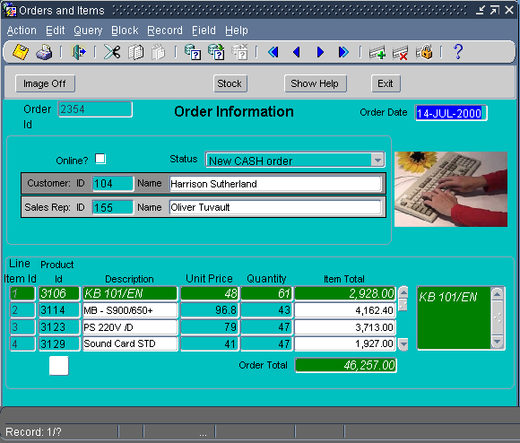
Starting a Run-Time Session
Client Tier
Middle Tier: Application Server
Web Browser
Web Server
Static HTML files
OC4J
or HTTP Server
URL
http://summit.com:8888/forms90/f90
7
Forms Services
Forms Servlet
Forms Listener Servlet
Forms Runtime Engine
8
8
Forms Application Executables
FMX files
MMX files
PLX files
DB
Notes:
Starting a Run-Time Session (continued)
7. The Forms applet displays the user interface of the application in the main window of the user’s Web browser.
8. The Forms Listener Servlet, working through OC4J or the HTTP Server, manages communication between the Forms applet and the Runtime Engine.
Technical Note
More information about the Oracle Forms Listener Servlet is available in the Oracle white paper: Oracle9i Application Server Forms Services Forms6i Patch 8: Oracle Forms Listener Servlet for Deployment of Forms on the Internet.
Instructor Note
Explain the process of using FTP to move a form from NT to the middle-tier server, compiling the form, and then running it from a browser. As you present the next few slides, explain to the students that the Forms Services run on the middle tier, and that this is where the run time environment variables are set.

Slide 9

The Forms Servlet
URL Pointing to Forms Servlet
http://summit.com/forms90/f90servlet?form=customers.f
Desktop Client
Application Server
Web Server
Static HTML files
HTTP Server or OC4J
formsweb.cfg
basejini.html
Forms Services
URL PARAMETERS:
?form=customers.fmx
&userid=un/pw@db
&buffer_records=NO
...
Forms Client
Base HTML files
Forms Servlet
Forms Listener Servlet
Forms Runtime Engine
Dynamic
HTML file
is created
Notes:
The Forms Servlet
The Forms Servlet is a Java servlet that creates a dynamic HTML file by merging information from the following sources:
The Forms Web configuration file
The Forms base HTML file
The application’s URL parameters

Slide 10
The Forms Client
Desktop Client
  Generic Java applet
  Responsibilities:
    Displays the form’s user
    interface
    Processes user interaction
    back to Forms Services
    Processes incoming
    messages
    from Forms Services
Forms Client
Generic
Java applet
Notes:
The Forms Client
The Forms Client is a generic Java applet. Forms Services dynamically downloads this applet and automatically caches it on the client machine. The Forms Client consists of a set of Java classes. At startup, only those Java classes that are necessary to initialize the application are downloaded. Additional class files are downloaded dynamically, as needed, to support additional user interface activity.
You do not have to deploy a separate Java applet for each application. The same generic applet is used to run any Forms Services application, regardless of its size and complexity.
Responsibilities of the Forms Client
The Forms Client represents the user interface layer and has three primary functions:
To render the Forms Services application display for the user
To efficiently process user interaction back to Forms Services
To process incoming messages from Forms Services and translate them into interface objects for the end user efficiently

Slide 11

The Forms Listener Servlet
HTTP Server
or
OC4J
Forms
Listener
Servlet
HTTP/
HTTPS
Java Servlet that:
  Creates Forms
  Runtime
  process
  for each client
  Stops the Runtime process at session end
  Manages network communications between client and Forms Runtime process
  Communicates through Web server process
Middle Tier
Forms
Runtime
Process
Notes:
The Forms Listener Servlet
The Forms Listener Servlet is a Java servlet that runs in a Web server equipped with a servlet engine, such as OC4J. The Web server directs HTTP requests for the Forms Listener Servlet directly to the servlet instances.
The Forms Listener Servlet is in charge of:
Managing the creation of the Forms Runtime process for each client
Managing the network communications that occur between the client and its associated Forms Runtime process, through the Web server
This means that the client sends HTTP requests and receives HTTP responses from the Web server process itself. Since the Web server acts as the network endpoint for the client, there is no need to expose additional server machines and ports at the firewall.

Slide 12
The Runtime Engine
The Forms Runtime Engine:
  Is a process (ifweb90) that runs on the Application Server
  Manages application logic and processing
  Communicates with the client browser and the database
Notes:
The Forms Runtime Engine
The Forms Runtime Engine is a process on the Application Server that is started by the Forms Listener Servlet. You cannot start the runtime engine directly.
The Forms Runtime Engine handles all the application logic and Forms functionality and executes the code written into the application. It manages requests from the Forms Client and sends metadata to the client to describe the user interface. It connects to and communicates with the Oracle9i database via Oracle Net Services, the replacement for Net8 and SQL*Net.

Slide 13
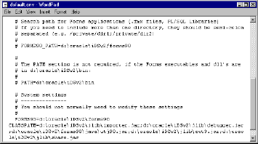
Defining Forms Environment Variables for Run Time
SET ON MIDDLE TIER MACHINE (Used at run time):
  FORMS90_PATH
  ORACLE_PATH
  CLASSPATH
}
Windows NT: Modify in Registry (REGEDIT.EXE or REGEDT32.EXE)
  - - - - -
Windows NT: Modify in Control Panel > System
For Forms deployment, the settings in the environment control file override system settings.
Notes:
Oracle Developer Environment Variables
Introduction
Oracle Forms Developer uses many environment variables. These have default values, all of which you can modify in your own environment for different applications.
Setting Search Paths for Run Time
Forms uses some environment variables set on the middle tier machine to search at run time for files such as forms, menus, and libraries. This enables you to build applications that are portable across platforms and directory structures by avoiding hardcoded paths in file references.
Forms searches the following paths in order until the required file is found:
The current working directory
Directories in FORMS90_PATH
Directories in ORACLE_PATH

Slide 14
Defining Forms Environment Variables for Design Time
SET ON iDS MACHINE (Used by Forms Builder):
  FORMS90_BUILDER_CLASSPATH
Windows NT: Modify in Registry (REGEDIT.EXE or REGEDT32.EXE)
Notes:
Oracle Developer Environment Variables (continued)
Setting Search Paths for Design Time
Forms Builder also needs access to certain Java classes for some of its features, such as Help, the debugger, and the Java importer. You set FORMS90_BUILDER_CLASSPATH so that Forms Builder can find the Java classes it needs during development and testing of an application.
These environment variables must be set on the machine where Oracle9iDS is installed.

Slide 15
Forms Files to Define
Environment Variables
Environment control file:
  \forms90\server\default.env OR
  Other file specified in Forms configuration file
Forms configuration file:
  \forms90\server\formsweb.cfg or other
  Used to specify:
    System parameters, such as envfile and workingDirectory
    User parameters, such as form and userid
    Settings for the Java client
    Other settings
Notes:
Oracle Developer Environment Variables (continued)
Modifying Environment Variables
In a Windows NT 32-bit environment, use the Windows Registry to modify these paths, except for CLASSPATH, which is set in the System settings of the Control Panel. You can also override these settings at run time in the file that controls the Forms run time environment, which is the default.env file unless a different file is specified.
Using an environment control file makes it easier to deploy the application on any platform. You can specify which environment control file to use in a special Forms configuration file called by default formsweb.cfg. In this configuration file, you can set system parameters, such as the name of the environment control file. You also can set parameters to control which form to run, the userid, aspects of the Java client and the HTML file that contains the Java applet, and many other settings.
Instructor Note
Warn students to take care when modifying environment variables, because they immediately affect the environment and mistakes can prevent applications from running. Whenever possible later in the course, point out when these variables are used, and remind students to avoid hard coding path names in their applications.

Slide 16
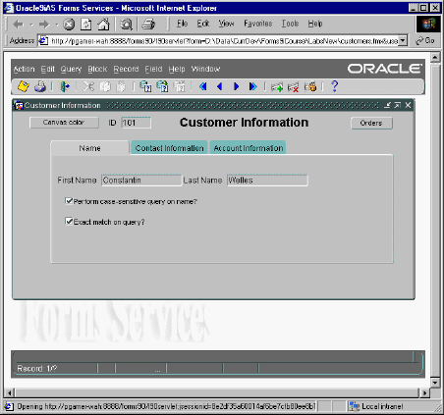
What You See at Run Time
1
3
4
    1. Browser window
    2. Java applet (contained within browser window)
    3. Default menu (contained within applet)
    4. Menu toolbar (contained within applet)
    5. Console (contained within applet)
5
2
Notes:
What You See at Run Time
At run time, you will see the following components:
1. Browser window
2. Java applet (contained within browser window)
3. Default menu (contained within applet)
4. Menu toolbar (contained within applet)
5. Console (contained within applet)
What is the Default menu?
The Default menu, which is part of all Oracle Forms Developer applications, is an alternative to keystroke operations. You can replace or customize the Default menu to introduce your own functionality into a form module.
What is the Menu toolbar?
The Menu toolbar contains buttons corresponding to menu items. At run time, it appears above any user-defined toolbars. It executes the same code as menu items, and it is a shortcut to menu commands that does not duplicate code or effort.

Slide 17
Notes:
What You See at Run-Time (continued)
What is the console?
The console is the generic name for the standard features that provide information at run time. The console is displayed at the bottom of the window and consists of:
The message line that displays both Forms and application-specific messages.
The status line that displays a variety of indicators to reflect the current state of the form module.
Instructor Note
Demonstration: Start an OC4J instance (explained to students in next lesson). In Forms Builder, open the form module Customers and run it with the Run Form button. Point out the Browser window, Java applet, Default menu, Menu toolbar, and Console components. Describe the elements of the URL in the browser.
Select Help > Keys from the menu. Execute an unrestricted query. Execute a restricted query to retrieve information about the customer with the ID of 212.
Leaving this browser session open, start another browser session; copy the URL from the first session into the second. Add the following to the end of URL: &lookAndFeel=generic (the default Look and Feel is "oracle"). Point out the different appearance of the user interface, especially the rounded appearance of the buttons and the new look of the Menu toolbar.
Terminate these run-time sessions by exiting the forms, and then closing the browser windows. Be sure to advise students to always exit the form to terminate the applet before closing the browser window.

Slide 18
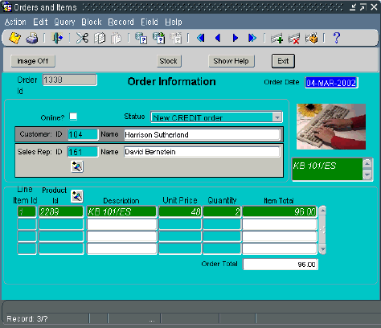
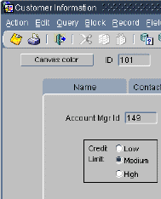
Identifying the Data Elements
1
2
3
4
5
6
7
8
9
10
Notes:
Identifying the Data Elements
A Forms application may contain many different kinds of data elements:
1. Prompts
2. Text Items
3. Boilerplate graphics
4. Check boxes
5. Boilerplate text
6. Display items
7. List items
8. Push buttons
9. Image items
10. Radio groups
Not Pictured:
Hierarchical tree items
Chart items
Custom items

Slide 19
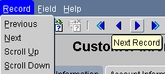
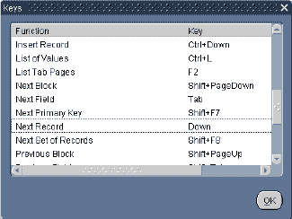
Navigating a Forms Developer Application
Methods of Navigation:
  Default menu
  Menu toolbar
  Mouse
  Buttons
  Function keys
Notes:
Navigating a Forms Application
The Default Menu
The Default menu is automatically available in a form, unless it is disabled or replaced with a customized menu. Select options from the menu by using the mouse or function keys. At run time, use the menu to perform the following tasks:
Move the cursor and navigate between data blocks, records, and items.
Save or clear all changes.
Execute queries.
Insert new records or delete existing records.
Invoke Help.
The Menu Toolbar
You can use the Default menu toolbar buttons to perform the following operations also available through the Default menu:
Save all changes.
Exit the form.
Execute queries.
Navigate between data blocks or records.

Slide 20
Notes:
Navigating a Forms Application (continued)
Insert new records or delete existing records.
Invoke Help to see properties of an item.
The Mouse
You can use the mouse to navigate and to perform many user operations in a bitmapped environment without needing to learn the function keys. Use the mouse to perform the following actions:
Move the cursor.
Select from a menu.
Select from an LOV.
Select or clear a check box.
Select a button, including a radio button.
Switch to an open window.
Respond to an alert.
Scroll records or lines by using a data block or item scroll bar.
Manipulate a custom item.
Buttons
Web applications often use buttons as a means of navigation. You can click buttons with the mouse. Use buttons to perform the following tasks:
Move input focus.
Display a LOV.
Invoke an editor.
Invoke another window.
Commit data.
Issue a query.
Perform calculations.
Exit the form.
Function Keys
In addition to navigating with the mouse, you can move from item to item in sequence with function keys. Use function keys to perform the following tasks:
Navigate between data blocks, records, and items.
Execute queries.
Insert new records or delete existing ones.
Invoke Help.
To view a list of keys and the functions they perform, select Help > Keys, or press [Ctrl]+K.
Instructor Note
Demonstration
From Forms Builder, run the ORDERS form. Point out the main data elements. Show the different means of navigation.

Slide 21
Modes of Operation: Enter-Query Mode
Allows:
  Unrestricted and restricted queries
  Record count by using Query > Count Hits
Does not allow:
  Navigation out of current data block
  Exiting run-time session
  Certain functions
  Insert, update, delete
Notes:
Modes of Operation
Forms Builder has two main modes of operation: Enter-Query mode and Normal mode.
Enter-Query mode
Use Enter-Query mode to enter search criteria for a database query. In Enter-Query mode, your keystrokes are interpreted as search criteria for retrieving restricted data.
What you can do in Enter-Query mode
Retrieve all records.
Retrieve records by using selection criteria.
Retrieve records by using the Query/Where dialog box.
Obtain the number of records that will be retrieved before fetching them from the database by using Query > Count Hits.
What you cannot do in Enter-Query mode
Navigate out of the current block.
Exit from the run-time session.
Use certain functions, such as Next Record.
Insert new records.
Update existing records.
Delete records.

Slide 22
Modes of Operation: Normal Mode
Allows:
  Unrestricted queries
  Insert, update, delete
  Commit (Save)
  Navigation out of current data block
  Exiting run-time session
Does Not Allow:
  Restricted queries
  Query/Where dialog box
Notes:
Normal Mode
Use Normal mode to insert and alter records in the database. In Normal mode, your keystrokes are interpreted as either the entering of new records or the altering of existing ones.
What you can do in Normal mode
Retrieve all records.
Insert new records.
Update records.
Delete records.
Commit (Save) records.
Rollback (Clear) records.
Navigate outside of the current data block.
Exit the run-time session.
What you cannot do in Normal mode
Retrieve a restricted set of records.
Invoke the Query/Where dialog box.

Slide 23
Retrieving Data
Unrestricted query
Restricted query
A B C D
A B C D
1
1
2
2
3
4
A
B
C
D
A
B
C
D
1
1
2
2
3
3
4
4
Notes:
Retrieving Data
You can use a form module to retrieve information from the database without knowing any SQL syntax. However, if you are an experienced SQL user, you may want to supplement Oracle Forms Developer default processing with your own SQL predicates. There are two general types of queries:
Performing an unrestricted query
You can retrieve unrestricted data by performing one of the following actions:
Select Query > Execute.
Press the appropriate function key.
Click the Execute Query button.
Note: You cannot perform a query while you have unsaved updates, inserts, or deletes. Either save or undo the changes before you continue with the query.

Slide 24
Retrieving Restricted Data
  Do not use quotation marks with character and date items.
  The LIKE operator is implied with % or _.
  Use hash (#) in front of SQL operators.
  Use Query/Where for complex query conditions.
  Use default date format (DD-MON-YY) in Query/Where.
  Use quotes around literals in Query/Where.
Notes:
Performing a Restricted Query
You can perform a restricted query by using any one of the following methods:
Matching values
Matching patterns (wildcards)
A Query/Where dialog box for user entry of SQL predicates
Valid Search Criteria

Slide 25
Notes:
Performing a Restricted Query (continued)
How to perform a restricted query
You can perform a restricted query with the following steps:
1. Perform one of the following:
Select Query > Enter.
Click the Enter Query button.
Press the appropriate function key.
2. Enter-Query displays on the status line.
3. Enter search criteria into appropriate items.
4. Perform one of the following:
Select Query > Execute.
Click the Execute Query button.
Press the appropriate function key.
Note: Forms Builder constructs a select statement by using the AND operator for all specified conditions.
Instructor Note
The default date format is dependent on the language/territory. In Oracle8i Release 2
(8.1.6), the default date formats were modified, replacing ’YY’ with ’RR’ and ’YYYY’
with ’RRRR’. For example, if NLS_LANG is set to Finland, then the default date
format will be DD.MM.RRRR.

Slide 26
Query/Where Dialog Box
  Invoke by:
    Entering :variable_name
    Executing query
  Used to write:
    Complex search conditions
    Queries with OR predicates
    ORDER BY clause
Notes:
Using the Query/Where Dialog Box
The Query Where dialog box is a window in which you enter complex search criteria by using raw SQL. Using the Query/Where dialog effectively requires knowledge of SQL. Use Query/Where to perform the following tasks:
Write complex search conditions.
Write queries with OR predicates.
Order the result of a query.
Note: Forms Builder logically uses the AND operator to append the Query/Where conditions to any other search criteria (including those imposed by the form designer) and constructs a SELECT statement.
Example
1. To restrict the query to orders with a Sales Rep ID (:S) of 11 OR an Order ID (:O) between 100 and 200, enter the following in the Query/Where dialog box:
:S = 11 OR :O between 100 and 200
2. To sort the data by Sales rep ID (:S), enter the following in the Query/Where dialog box:
ORDER BY :S
If you enter an ORDER BY at run time, it overrides any ordering defined by the designer.

Slide 27
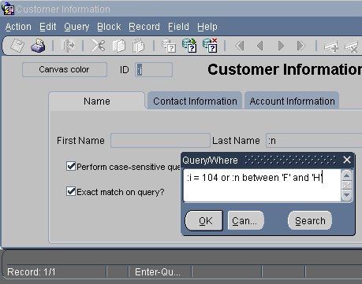
Query/Where Dialog Box
:i
:n
:i = 104 OR :n BETWEEN ‘F’ and ‘H’
Notes:
How to Use the Query/Where Dialog Box
To use the query/where box to enter query criteria:
1. Perform one of the following:
Select Query > Enter.
Click Enter Query.
Press the appropriate function key.
2. Enter a colon (:) followed by a unique character variable name in one or more items.
3. Perform one of the following:
Select Query > Execute.
Click Execute Query.
Press the appropriate function key.
Note: Alternatively, you can select Query > Count Hits if you simply want to know how many records will match your criteria.
The Query/Where dialog box is displayed.
4. Enter the search criteria by using variables, SQL, and logical operators. Click OK.
Note: To perform a query without any variables, type only the colon (:) and execute the query.
Doing so also displays the Query/Where dialog box.

Slide 28
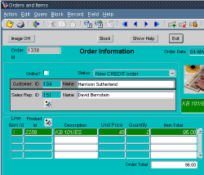
Inserting, Updating, and Deleting
Memory
Deletes
Updates
Inserts
Form module
Notes:
Inserting, Updating, and Deleting Records
Upon entering a typical form module you are in Normal mode. This means that Forms Builder regards anything that you type into a blank record as an insert and anything that you type over an existing record as an update.
How to insert a record
To insert a record, perform the following steps:
1. Ensure that you have the cursor positioned on a blank record by performing one of the following steps:
Scroll down until you find a blank record (always the last in the block).
Select Record > Insert.
Click Insert Record (green +).
Press the appropriate function key.
2. Enter the data into the relevant items.

Slide 29
Notes:
Inserting, Updating, and Deleting Records (continued)
How to update a record
To update a record, perform the following steps:
1. Select Query > Enter.
2. Enter the search criteria to retrieve the appropriate record.
3. Select Query > Execute to retrieve all records that satisfy your specific search criteria.
4. Scroll through the records, stopping at the record to be updated.
5. Update the record.
How to delete a record
To delete a record, perform the following steps:
1. Select Query > Enter.
2. Enter the search criteria to retrieve the appropriate record.
3. Select Query > Execute to retrieve all records that satisfy your specific search criteria.
4. Scroll through the records, stopping at the record to be deleted. Delete the record by taking one of the following actions:
Select Record > Remove to clear the record and mark it for deletion.
Click Remove Record (red X) to clear the record and mark it for deletion.
Press the appropriate function keys.

Slide 30

Making Changes Permanent
Memory
To commit or
rollback:
  Select Action > Save to make changes permanent.
  Select Action > Clear All to discard changes.
Deletes
Updates
Inserts
Menu
or
Toolbar
Notes:
Making Inserts, Updates, and Deletes Permanent
To make any inserts, updates, or deletes permanent you must save (commit) them to the database. To do this, take one of the following actions:
Select Action > Save.
Click Save in the menu toolbar.
Discarding inserts, updates, and deletes
To discard any inserts, updates, or deletes, you must clear the records (rollback) instead of saving. Perform a rollback by selecting Action > Clear All.
Exiting a run-time session
You exit the run-time session by taking one of the following actions:
Select Action > Exit.
Click Exit.
Press the appropriate function keys.
Note: By default, you cannot exit the form while you have unsaved updates, inserts, or deletes. You need to either save or undo the changes before you can exit.

Slide 31
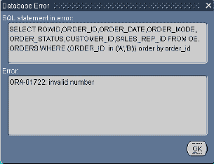


Displaying Errors
  Use to view Oracle errors
  Select Help > Display Error
  Shows Database Error window:
    SQL statement
    Error information
Notes:
Displaying Errors
If an Oracle error is displayed on the message line while you are operating a form application, you can view the underlying SQL code by selecting Help > Display Error.
Example
Here is the SQL statement in error and its corresponding error:
SELECT order_id, order_date, order_mode, order_status,
customer_id, sales_rep_id
FROM orders
WHERE (order_id in ('a','b'))
ORA-01722: invalid number
Note: Selecting Help > Display Error displays only those errors where the error on the message line is preceded by ORACLE error.

Slide 32
Summary
In this lesson, you should have learned that:
  You can run a Forms application in a Web browser
  At run-time:
    The Forms Client is downloaded
    The Forms Servlet creates a start HTML file
    The Forms Listener Servlet starts a Runtime session and maintains communication between it and the Forms Client
    The Runtime Engine carries out application logic and maintains a database connection on behalf of the Forms Client
Notes:
Summary
This lesson introduced the operator interface of Forms Builder. The following concepts were covered in this lesson:
The run-time environment for Forms:
Running a form in a Browser
Starting a run-time session: The Forms Servlet, the Forms Client, and the Forms Listener Servlet
The data elements of a form

Slide 33
Summary
  Users navigate a Forms application using the menu, toolbar, the mouse, buttons, or function keys
  Executing a query returns all records, unless the query is restricted by search criteria
  The two modes of operation are normal mode and enter query mode
  In normal mode you can insert, update, and delete records and commit changes to the database.
  You display database errors from the menu (Help > Display Error)
Notes:
Summary (continued)
Navigation methods
Modes of operation:
Normal mode
Enter-Query mode
Retrieving data by performing:
Restricted queries—you supply search criteria
Unrestricted queries—you supply no search criteria
Inserting, updating, and deleting records
Saving or clearing changes
Displaying database errors

